Slide 1
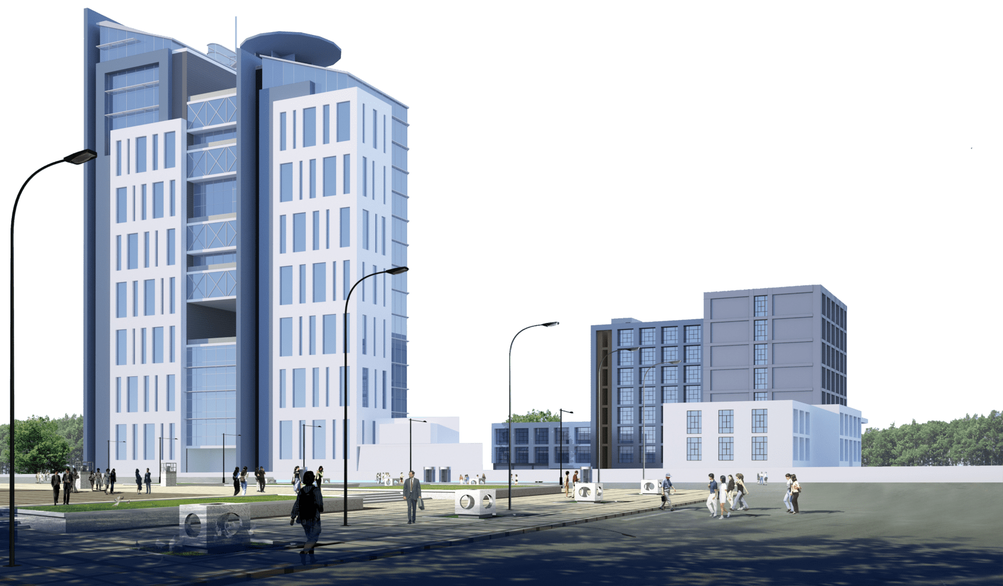
Project Kick-off Meeting for Implementation of Campus Management Application at World Skill Center (WSC) by Sustainable Outreach And Universal Leadership (SOUL) Limited
18-01-2023 & Time

Slide 2
Agenda
Project Details
Scope of the Project
Product Features
Key Migration / Integration requirements
Project Assumption
Engagement Model
Execution Methodology
Project Plan with Key Milestones
Responsibility Assignment Matrix - RACI
Key Team members- SOUL
Working Team details - WSC
Risk
Dependencies
Escalation Matrix
Governance Model
Change Management Process
Next Steps
Value Proposition

Slide 3
Project Details
Project Name | Campus Management Application for World Skill Center (WSC)
Package Number | PKG 0111
Tender Number | OSDA/WSC/Goods/M7-2022
Planned Start Date | 11-Jan-2023
Contractual Value | ₹1,54,58,000
Duration | 1 year (Implementation) + 1 year (Warranty) + 3 years(Maintenance)

Slide 4
Scope of the Project
Project Scope | Requirement
 | Design
 | Development
 | Configuration
 | Deployment
Project Acceptance Criteria | Submission of SRS document & Design Document
 | Implementation of Systems and handing over to the users for user acceptance test
 | End user training

Slide 5








Product Modules
1.Students Management Modules
Master Data (Students Profile, Personal Information, Contact Details, Academic Details)
Issue of Identity Card 
Hostel Management
Students Exams records of all 6 semesters
2.Academic System
Master Data (Course, Subjects, etc.)
Timetable preparation and management
Class Attendance of students
Examination
Result Analysis
3.Procurement & Inventory Management
Purchase Requisitions
Stores & Inventory Management
Receipt, verification & acceptance of goods
Stock entry
Invoice entry transfer to accounts/Directorate
Fixed assets Register
4.Human Resources Management System
Sanctioned Post Management (Recruitment, Promotions, Transfers,
Retirements, etc.)
Staff Profile including Educational qualification, Training, achievements etc.)
Annual Increments
Annual Internal Performance Review System
5.Finance and Accounting System
Receipt and Payment entries, etc.
Direct Transfer of caution money to students’ accounts.
Demand Register
Caution Money Register
Bank Reconciliation Statement.
Generation of Cash Book (PL)
Grants-in-Aid Register
Paid Voucher Register
Advances Register
Auditing and Tracking of pendency of Audit Paras etc
6.Training and Placement
Master data on potential Employers
Campus Interview Scheduling and Mapping
Students Database and eligible list
Messaging to students
Seminar / Conferences / Internships
Registrations, Participations, Results, Placements
Tracer study for 3 years etc.
Ability to integrate with the state portal for placement management under
Skill Development & Technical education Department
7.Infrastructure
Master data for Land and Buildings.
Allocation of Quarters
Database on ongoing Projects / Works
Estimate preparation monitoring for new Project / Work
Project Plan Monitoring
Security Services, support services monitoring
Maintenance and AMC

Slide 6



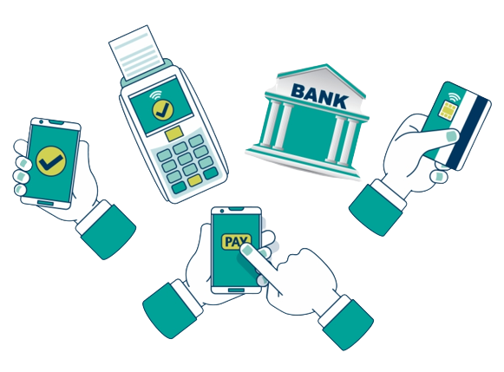




Key Integrations
Library Management
Learning Management
CMS system for managing Alumni Portal
Payment Gateway
Website
Digital Notice Board
Communication channels SMS / Whatsapp
(ERP Integration with applications part of organizations within Government of Odisha ecosystem which are associated with WSC)
Biometric System / RFID system
*Note : API for all Integration would be available before the start of development phase

Slide 7

Project Assumption
Changes requested after requirement document is signed off will be considered as a Change Request (CR)
Relevant WSC Stakeholders need to be available throughout the project execution phase as and when required
End users must be available to do the UAT during the scheduled time frame
API for all Integrations would be available before the start of development phase
Infrastructure required to deploy the proposed solution must be made available by WSC team

Slide 8
Engagement Model
SOUL
WSC
SOUL
WSC
TL, BA
End Users
Management
Management
Team Lead | TL
Business Analyst | BA
System Administrator | SA
Project Manager | PM
Development Team | DT
SOUL
WSC
UAT and
Data loading
Project Kick-off
SOUL
WSC
SA, PM, TL
Team
PM, TL, DT
SME’s
System Implementation
Discovery
Phase
SOUL
WSC
System Integration Testing
SOUL
WSC
System Requirement & GAP Analysis
SOUL
WSC
Business Analyst,
Team Lead
WSC
Stakeholders
Business Analyst, Project Manager,
Team Lead
WSC
Stakeholders
BA, TL
Team
BA, PM, TL
SME’s
Development & configuration
System design
SOUL
WSC
SOUL
WSC
Team Lead,
Development Team
DT, SA
Team
TL, DT
Team

Slide 9





Execution Methodology
Kick off Planning
Requirement Gathering & Design
Development & Customization
Testing
Implementation & Go-Live
Training
User goes through the base module
Requirement study and gap analysis.
Design documents & prototypes
Installation of base version of application.
Install & give access to WSC Users
Development of the different modules as per the Requirements & design
System Integration testing
User acceptance testing
Implementation of the final project
Deployment on the production server
Data Migration
User training & Knowledge transfer
Deliverables:
Base System
Deliverable:
SRS Document, High Level Design, Prototype
Deliverables:
Working System
Deliverables:
Test Plan
Deliverables:
Training Manual

Slide 10
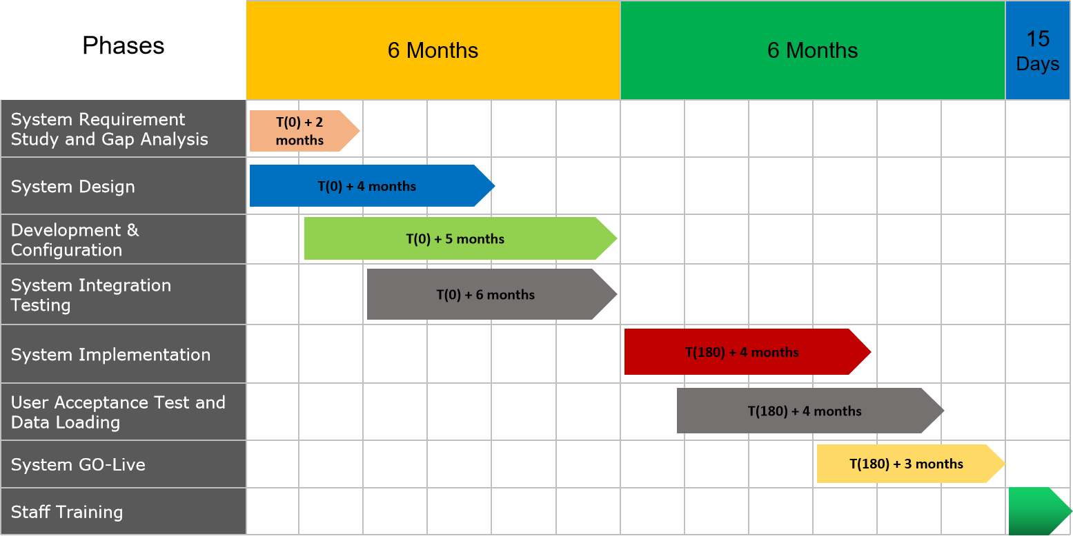
Project Plan and Milestones
Project Kick-Off - T(0)
Detailed project plan in a Excel format will be shared separately
The timelines mentioned here are indicative and will change as the discussion progresses between SOUL and WSC from Requirement Study phase
WSC Stakeholders need to be available throughout the project execution phase as and when required and will sign off the requirements in a timely manner during the planned time frame

Slide 11
Responsibility Assignment Matrix - RACI
Role | Project Manger | Delivery Team | WSC SME’s | WSC IT
Project Activities
Project Planning | A | R | C
Business Requirement Identification | A | R | R
High Level Design (HLD) | I | R/A | C
Development Configuration | A | R | I
System Integration Testing | A | R | C
UAT | C | R | R/A
Infrastructure Readiness | A | R | C | R
Application Deployment | A | R | C/I | C/I
User Training | A | R | R
Review of the Deliverables | R/A | C | R/A
Coordination with external teams for Integration | C | I | R/A
Data Loading | C | C | R/A | R/A
R - Responsible
A - Accountable
C - Consulted
I - Informed

Slide 12
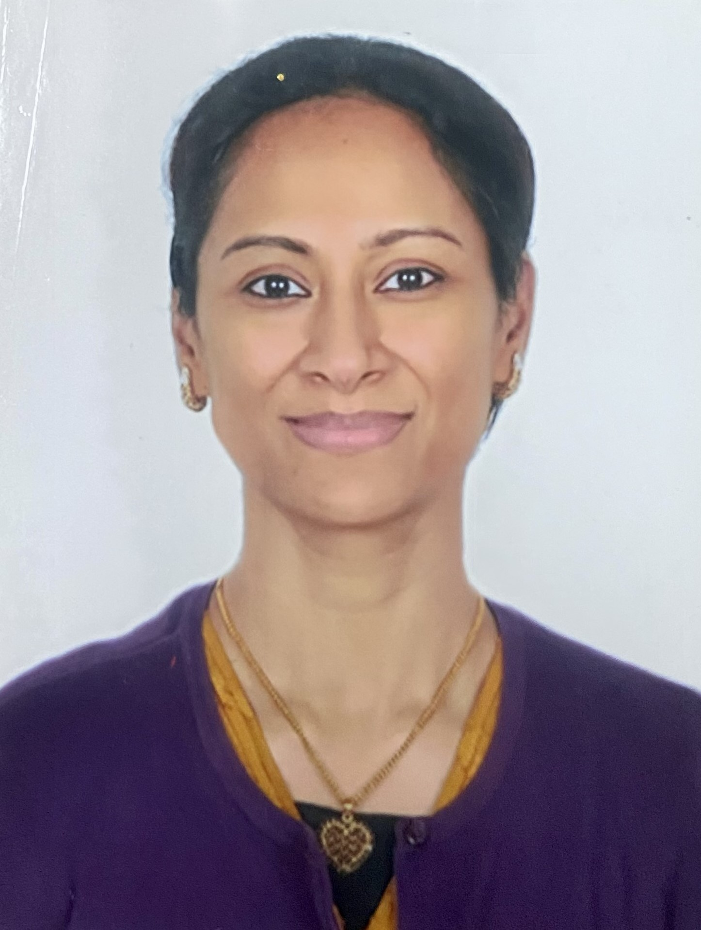
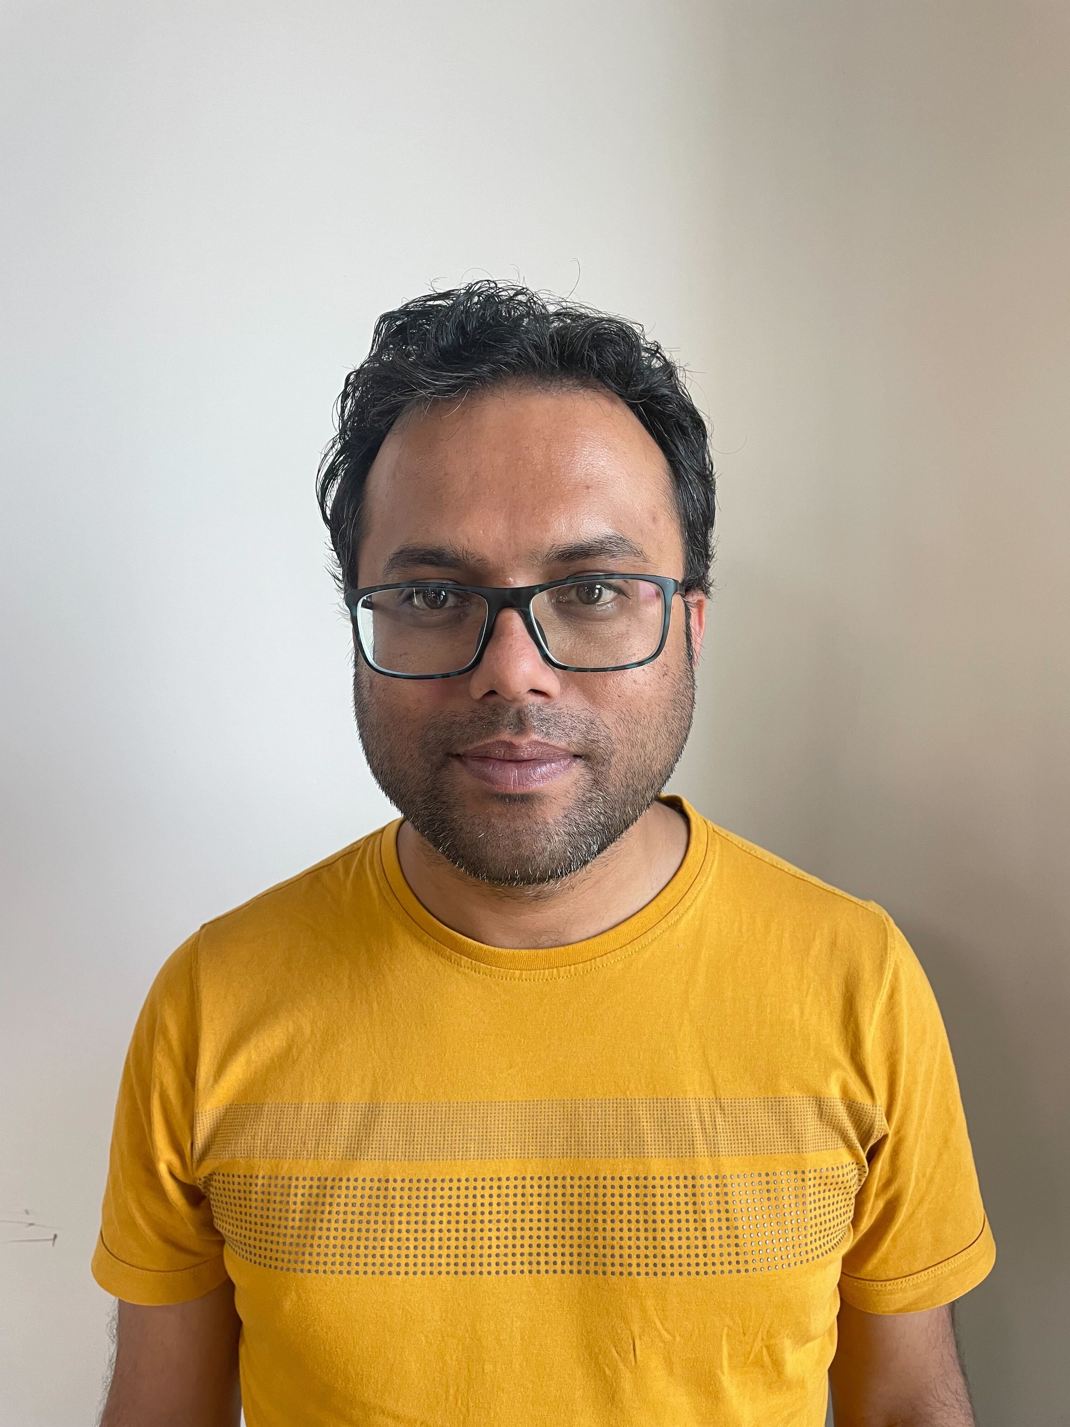
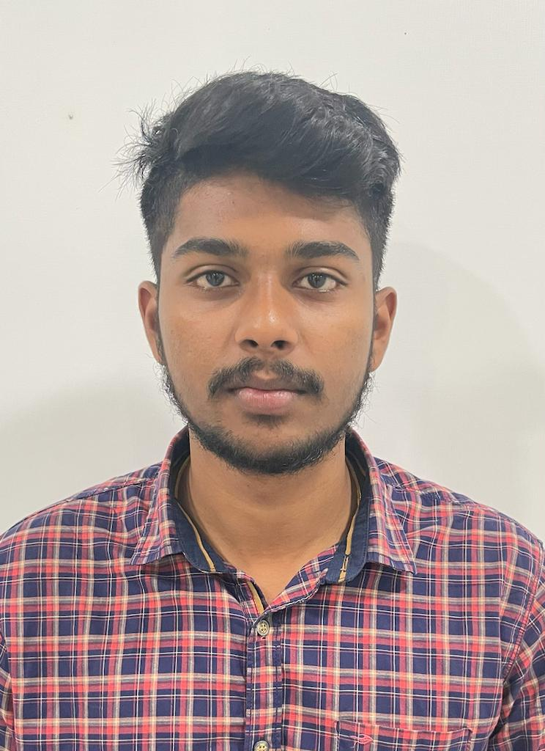
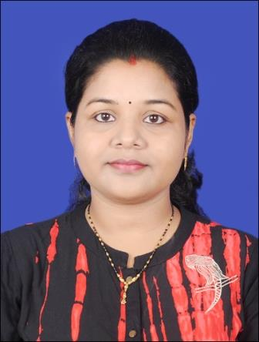

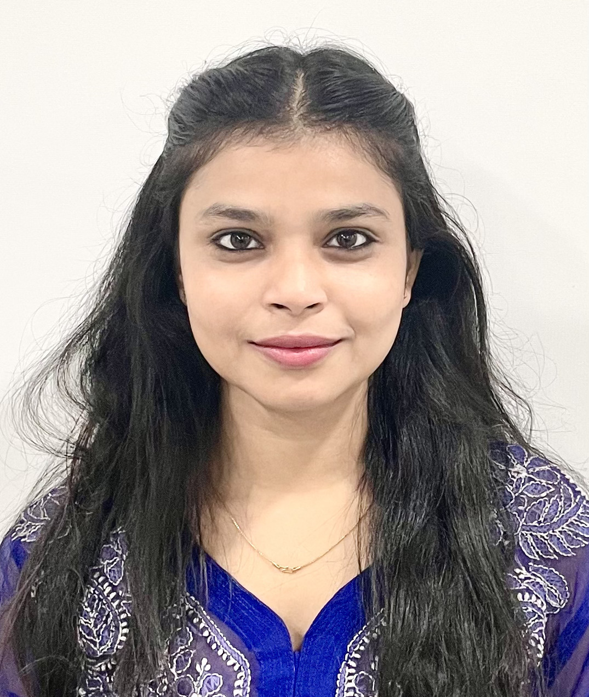


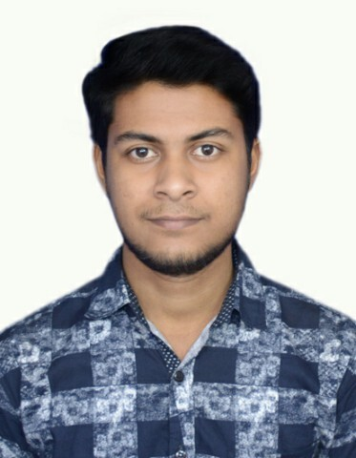
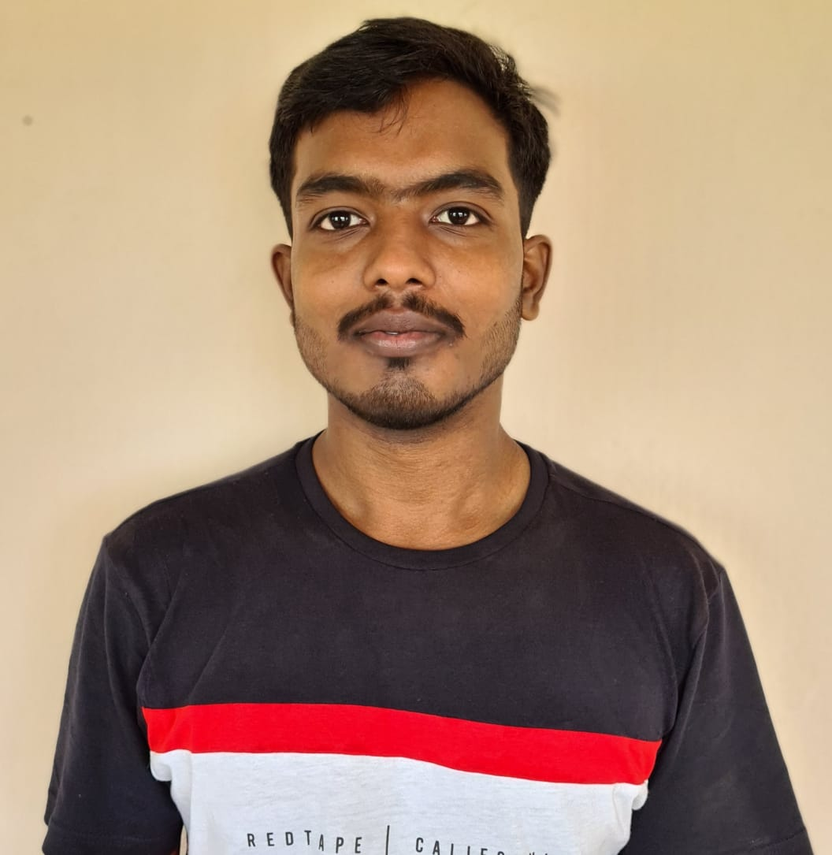


Working Team Details - SOUL
Sharmistha Panda (Project Manager)
sharmistha.panda@soulunileaders.com
9845047803
Abhishek Adhikari (Team Lead)
abhishek.adhikari@soulunileaders.com
8895552654
SK Tousiff Taj (Business Analyst)
tousiff.taj@soulunileaders.com
Rupali Bhatta (Developer)
rupali.bhatta@soulunileaders.com
Priytesh Shah (Business Analyst)
priytesh.shah@soulunileaders.com
Shuti Kumari (Developer)
shruti.kumari@soulunileaders.com
Sivashreet Maharana (Team Lead)
sivashreet.maharana@soulunileaders.com
Nehal Kumari (Developer) nehal.kumar@soulunileaders.com
Subhajit Saha (Developer)
subhajit.saha@soulunileaders.com
Rajendra Kumar Bera (Developer)
rajendra.bera@soulunileaders.com
Sharthak Kumar Rath (Developer)
sarthak.srath@soulunileaders.com
Rojalin Biswal (System Administrator)
rojalin.biswal@soulunileaders.com

Slide 13
Risks
Risk | Probability | Criticality | Mitigation
Exit of Critical Resources from Project | Medium | Medium | SOUL team needs to plan backup resources and provide adequate Knowledge Transfer
Business users may provide inconsistent requirements | Medium | High | Stakeholders should discuss to get the broad outline of ERP software
Business users may not provide all sets of requirements on time | High | High | Adequate training to be provided to business users along with training on familiarization with IT software
Delay in deployment due to untimely availability of hardware resources such as server | Medium | High | Server and other Hardware resources needs to be handed over before the Testing phase
Development may get delayed because of unavailability of API for third party integration | Medium | High | Project timeline schedule need to be shared with third parties to avoid the unavailability delay
Frequent or unexpected project scope expansion. | High | High | Change control board should be empowered so that change would move across phases post implementation
Change in WSC SME | Medium | Medium | WSC leadership team to ensure proper KT with the new team member and inform Feast team in advance
If Data template is not shared with WSC as per scheduled plan then, delivery will be impacted | Low | High | Data template should be provided by SOUL to WSC on time

Slide 14
Dependencies
Relevant WSC Stakeholders need to be available throughout the project execution phase as and when required
Timely input from WSC stakeholders on requirements and testing
WSC team will need access to ERP solution for UAT phase
After each deliverables by SOUL to WSC, WSC stakeholders will review and sign off the deliverable within 7 days of acceptance
WSC should provide master data to SOUL for project implementation
Hardware resources should be available for timely execution of deployment phase
WSC team need to ensure the data they provide is accurate

Slide 15
Escalation Matrix
Escalation Level | WSC | SOUL
Level 1 |  | Project Manager
Level 2 |  | Delivery Manager
Level 3 |  | Chief Business Officer (CBO)

Slide 16
Governance Model
Steering Committee
Overall project governance , direction & management oversight
Escalation point as needed
WSC
Level 3
CBO
Project Management Committee
Performance & management of project
Ensure on time delivery of the system
Address the issues & risks raised by the Working Committee
Delivery
Manager
WSC
Level 2
Working Committee
Development & delivery of the requirements
Addresses tactical and operational issues
Project Manager
WSC Project Manager
Meeting | Frequency | Governance Bodies | Purpose
Working level meeting | Weekly | Working Committee | Review progress against key milestones with Project team, leads and SOUL project manager Discuss concern areas or operational issues
Project Status Update Meeting | Fortnightly | Project Management Committee Working Committee | Monthly performance review Discuss outstanding and new issues Forecast of activities
Steering Committee Meeting | Monthly | Steering Committee Project Management Committee Working Committee | Project performance review Upcoming milestones and plans Issues requiring intervention

Slide 17




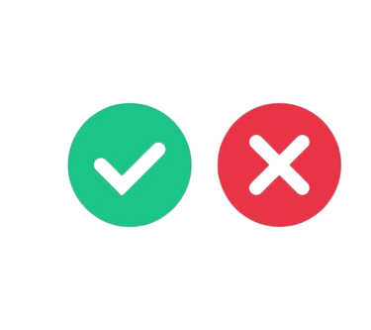
Change Management Process
Review
Assessment of the
implementation results
Request for Change
Change in the product feature which was not defined during requirement analysis phase
Implement Change
Development team will initiate the change implementation
Impact Analysis and Estimation
Development team will evaluate the implications of the change and estimate the additional effort and cost required to implement the change based on the evaluation.
Approve/ Deny
Post evaluation, Change Request Board will approve or deny implementation of change

Slide 18
Next steps
Action Item | Responsibility | Target Date | Status | Dependencies
Project Kick-Off | SOUL - WSC | 18-Jan-23 | Not Started | WSC stakeholders availability
Environment Availability | WSC | To be updated by WSC | Not Started | WSC to provide server
Base version Availability | SOUL |  | Not Started | Environment Availability
Start of System Requirement Study and Gap Analysis | SOUL - WSC | Post Project Kick-Off meeting | Not Started | WSC team availability

Slide 19
Thank You

